Slide 1
Programming Concepts with Python
Session 3
Instructor: Ms Laraib
1

Slide 2
Learning Objectives
By the end of the session, students can:
• Create and use variables
• Identify int, float, str, bool
• Take input and produce output
• Write decisions with conditions
• Use loops to repeat tasks
2

Slide 3
What Does a Program Do?
• A program is a set of instructions
• Computers follow instructions in order
• Programming turns a problem into steps
A computer program is a sequence of instructions written in a programming language that tells a computer how to perform a specific task.
3

Slide 4
From Problem to Program
A simple programming workflow
1. Understand: Know what goal or question you are trying to solve.
2. Input: Gather the data needed to start (e.g., numbers, text, user clicks).
3. Process: Perform calculations, actions, or decisions on that data.
4. Output: Display or deliver the final results.
4

Slide 5
What is Python?
Python is a high-level, general-purpose programming language.
It was created by Guido van Rossum and first released in 1991.
Python has simple, readable syntax that makes it easy to learn.
It is an interpreted language and supports multiple programming styles.
Python is widely used by beginners, developers, researchers, and organizations.

Slide 6
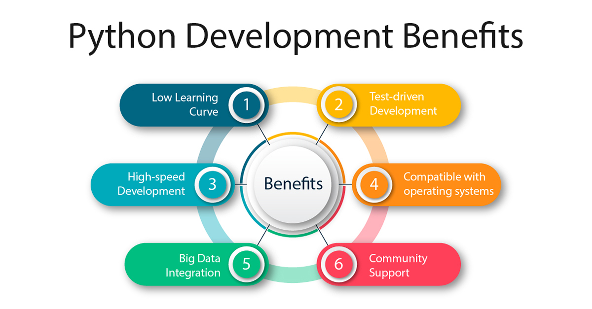

Slide 7
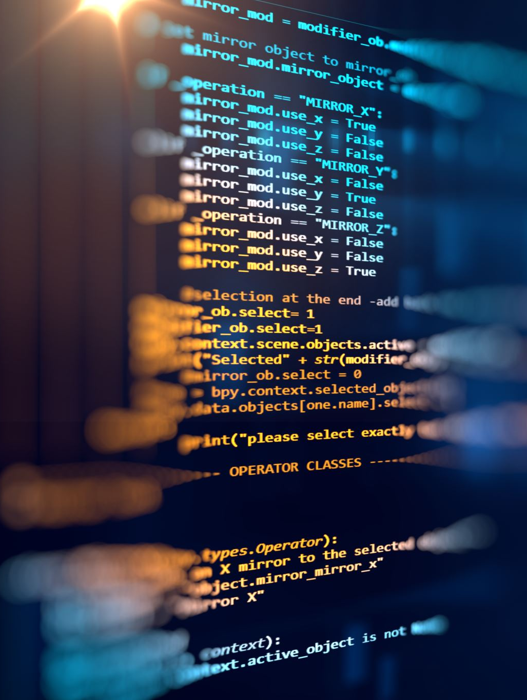
Features
Free and Open Source: Free to use, modify, and distribute.
Easy to Learn: Simple syntax makes Python beginner-friendly.
Readable Syntax: Code is clear, organized, and easy to understand.
High-Level Language: Handles many low-level details automatically.
Cross-Platform: Runs on Windows, macOS, and Linux.
Large Community Support: Offers extensive libraries, tutorials, and online help.
GUI Development: Supports graphical applications using libraries such as Tkinter and PyQt.

Slide 8
Applications of Python
1. Data Science and Data Analysis: Python helps analyze data, create charts, and find useful information using libraries such as Pandas and NumPy.
2. Artificial Intelligence (AI): Python is used to develop machine learning models, chatbots, and intelligent systems using tools such as TensorFlow and PyTorch.
3. Web Development: Python can build websites and web applications using frameworks such as Django and Flask.
4. Automation: Python can automate repetitive tasks, process files, and generate reports.
5. Game Development: Python can be used to create simple games and prototypes using libraries such as Pygame.

Slide 9
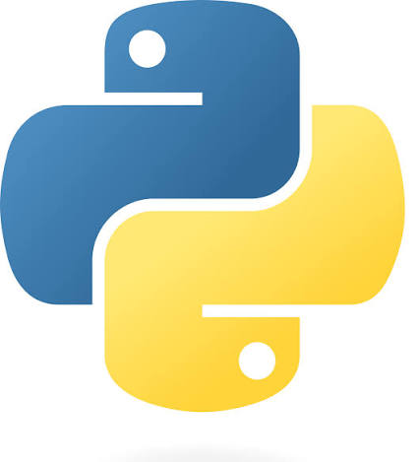



IDEs Used to Run Python Code
An IDE (Integrated Development Environment) is a software application that helps programmers write, run, test, and debug Python code.
Visual Studio Code (VS Code)
PyCharm
Jupyter Notebook
Google Colab https://colab.research.google.com/
Programiz Online Python Compiler https://www.programiz.com/python-programming/online-compiler/

Slide 10
Variables: Storing Information
A variable acts as a named container in computer memory used to store, retrieve, and manipulate data during program execution.
name = "Ali"
marks = 85
student_age = 15
score_total = 95.5
is_passing = True
5

Slide 11
Variable Assignment
• Python reads assignment from right to left
• The variable stores the resulting value
Assignment operator: The single equals sign is the assignment operator. It takes the value on the right side and stores it into the variable name on the left side.
x = 5
y = x + 3
x = 10
print(y)
What is the value of y?
6

Slide 12
Good Variable Names
Readable code is easier to understand
• Use names that explain the data
• Use snake_case for variables
• Avoid names like x, a, temp when meaning is unclear
Good: player_score = 10 (Easy to understand)
Bad: x = 10 (What is x?)
7

Slide 13
Data Types
• int → whole numbers
• float → decimal numbers
• str → text
• bool → True / False
age = 20
price = 99.5
name = "Ali"
passed = True
8

Slide 14
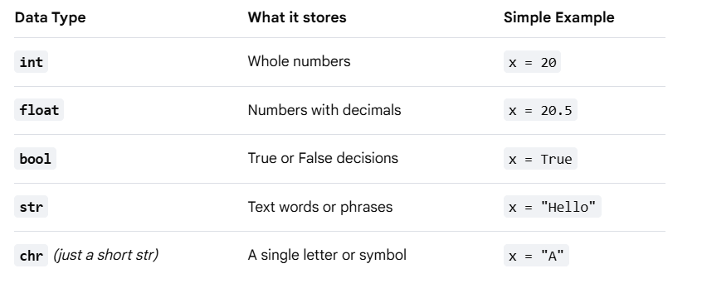
Data Types
age = 20
price = 99.5
name = "Ali"
passed = True
8

Slide 15
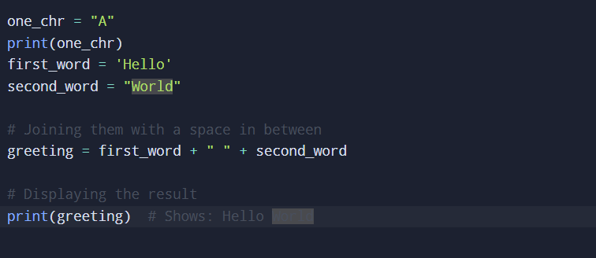
Strings
Text values in Python
Strings are text written inside quotes.
Use + to join (concatenate) strings.
Use print() to display text on the screen.
10

Slide 16
Boolean Values
True or False
• A Boolean has two values: True or False
• Booleans are useful for decisions
is_logged_in = True
is_game_over = False
11

Slide 17
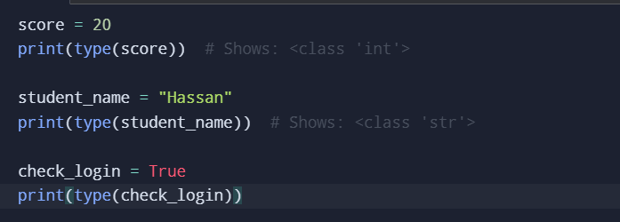
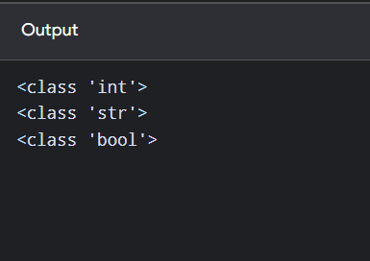
Check the Type
Use type() to inspect a value
type(value) returns the data type:
It acts like an investigator. If you pass a variable to it, it reports back whether it is an int, str, float, or bool.
score = 90
print(type(score))
• Predict the type of: score = 90.5
12

Slide 18
Output with print()
Display information to the user
The print() command displays text or numbers on your computer screen.
print("Hello")
name = "Sara"
print("Name:", name)
14

Slide 19
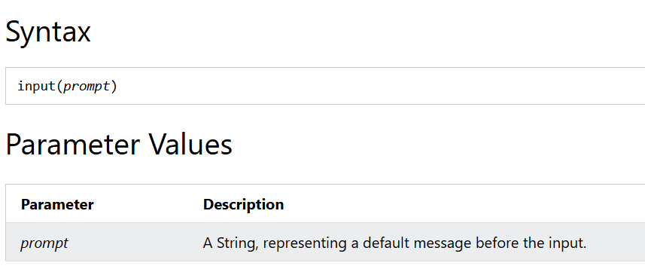
Input with input()
Let the user provide data
The input() function allows user input.
15

Slide 20
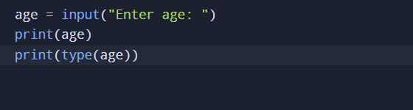
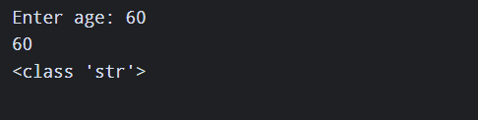


Convert when doing arithmetic:
You cannot do math on text. You must convert it to an integer using int() or a decimal using float() before doing any math.

Slide 21
Mini Activity: Calculator
Build a two-number calculator
• Ask for two numbers
• Add them
• Display the result
a = int(input("First: "))
b = int(input("Second: "))
print(a + b)
18

